Slide 1

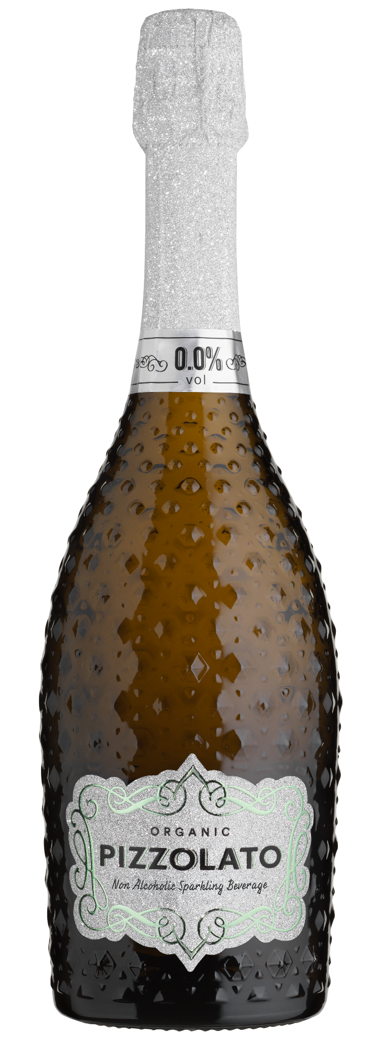
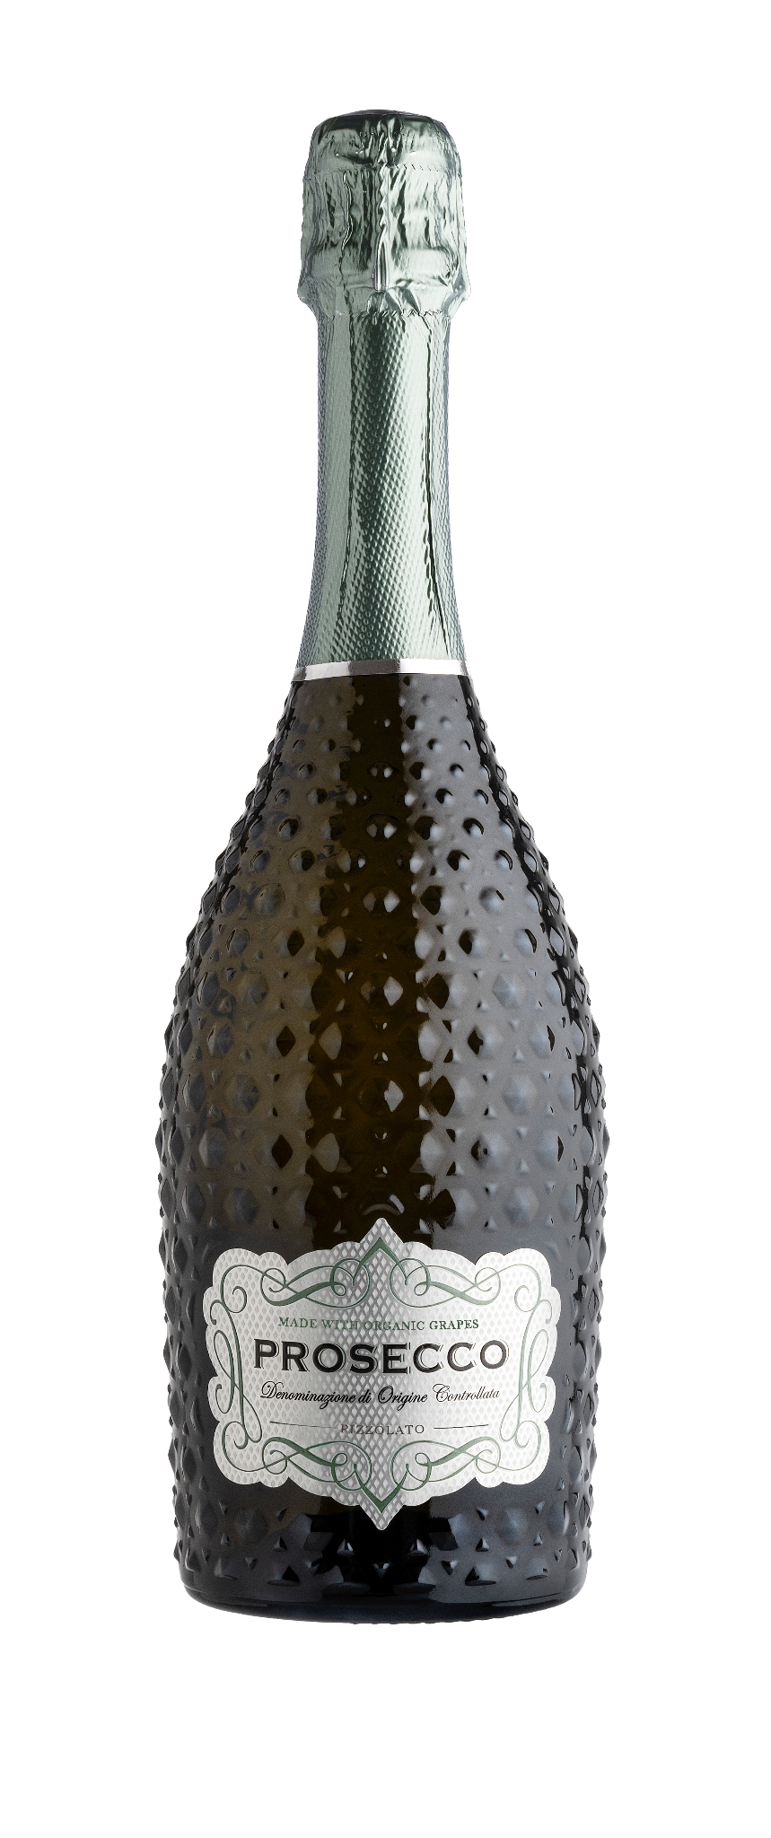
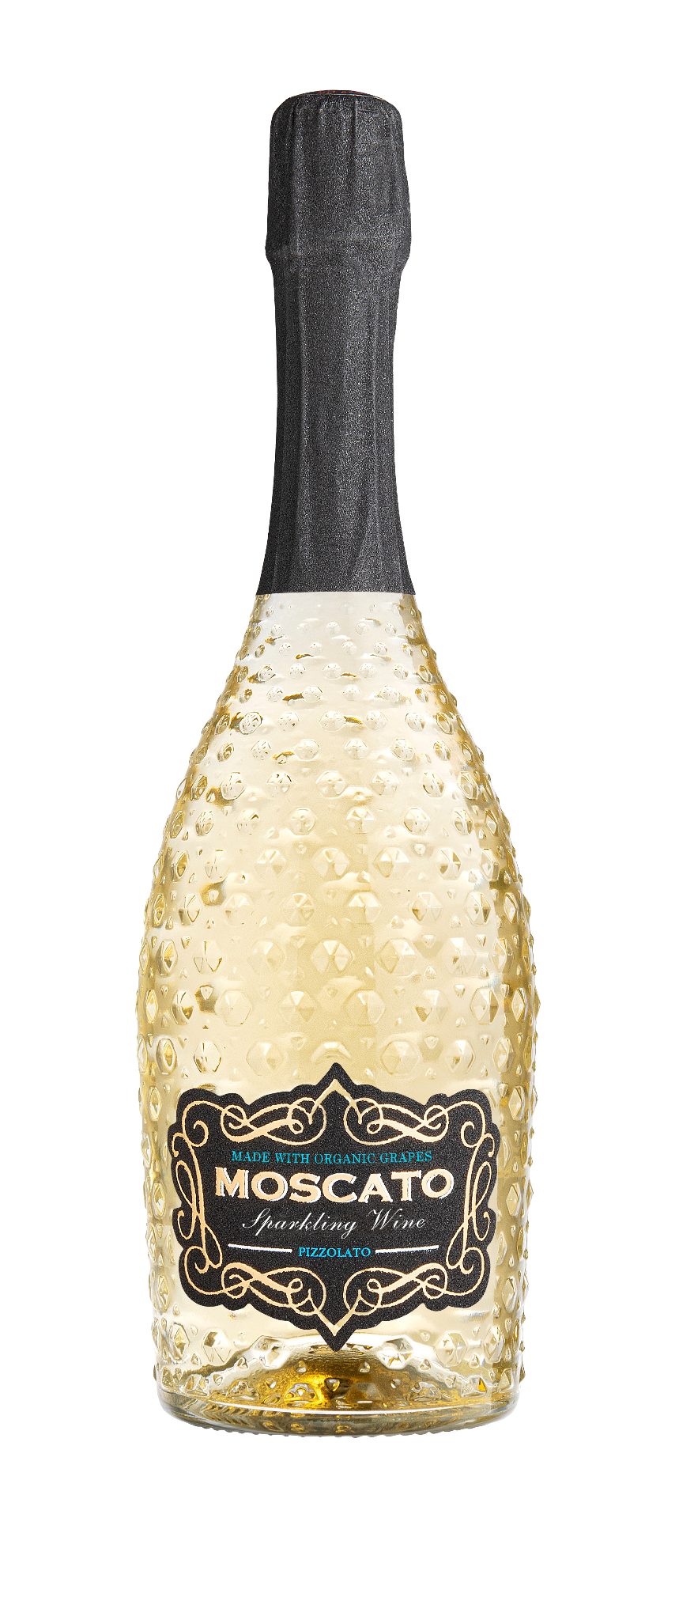
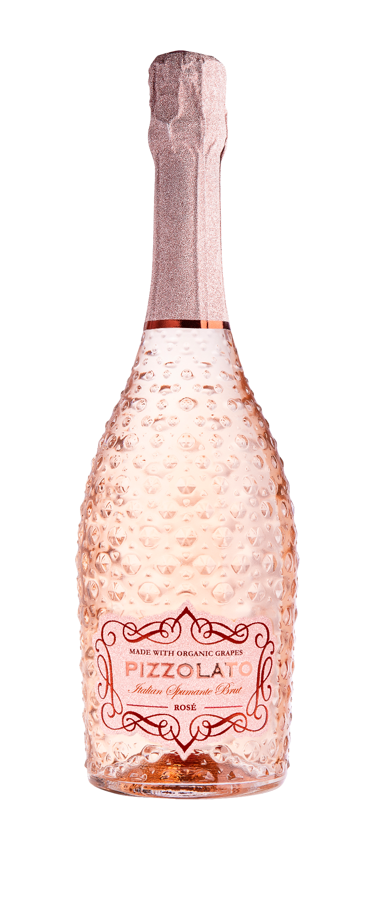
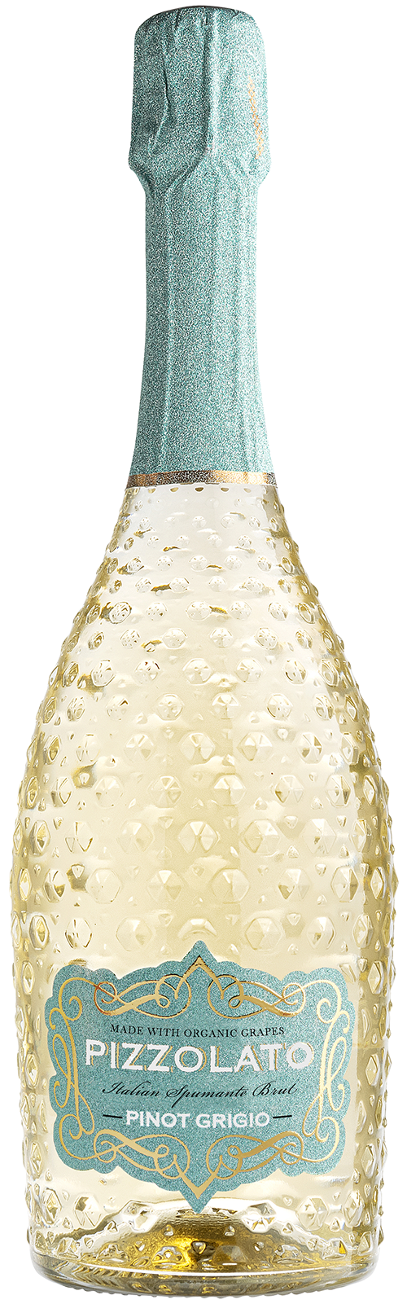
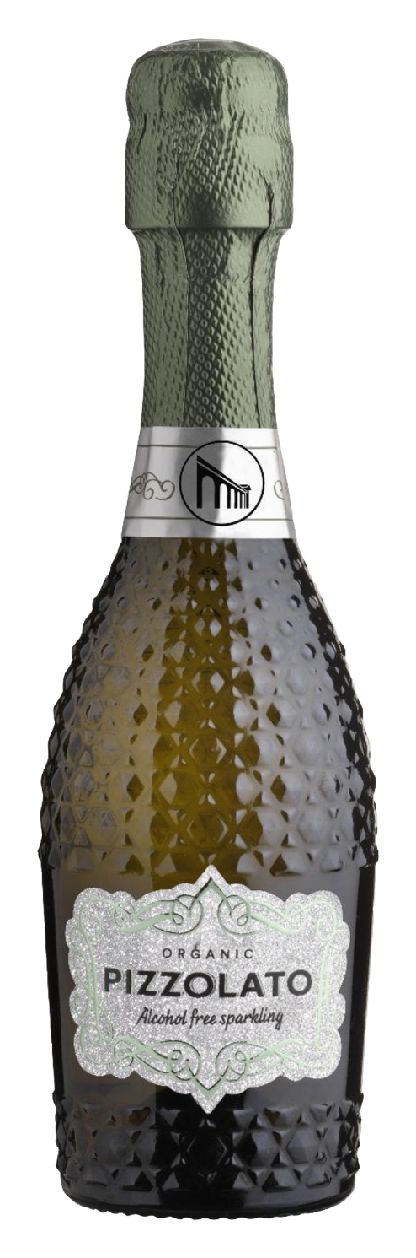

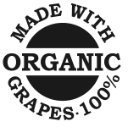
PIZZOLATO MUSE SPARKLING NON ALCOHOLIC WINE IS HERE!
Known for their delicious organic products and eye-catching packaging, Pizzolato’s non-alcoholic sparkling wine is the perfect addition to their extremely popular Muse line. With trends like ‘sober curious’ and ‘mindful drinking,’ more young people are choosing a different relationship with alcohol, and now there’s a sparkling option for everyone!
PIZZOLATO MUSE LINE
NUTRITIONAL FACTS
Servings: About 2 | Serv. Size: 12 fl.oz. (360mL)
Amount per Serving:
ABV: 0.0%
Calories: 50
Total fat: 0g
Total Carb: 10g
Total Sugars: 10g
To be served at 39.2℉ to 42.8℉.
PIZZOLATO SPARKLING WHITE WINE DOC PROSECCO SPUMANTE BRUT
PIZZOLATO SPARKLING MOSCATO
SPARKLING WINE
PIZZOLATO SPARKLING ROSÉ
SECCO SPUMANTE BRUT
PIZZOLATO SPARKLING PINOT GRIGIO
DOC DELLE VENEZIE
TASTING NOTES
Red Fruit
Peach
Elderflower
Citrus
FOOD PAIRINGS
Cheese
Pasta
Risotto
White Meat
The Pizzolato Brand is the #1 cumulative Organic Sparkling brand in the US (2.7MM)
FOB: $86
UPC: 812949028195
SCC: 812949028171
Available in 750ml & 187ml

