Slide 1
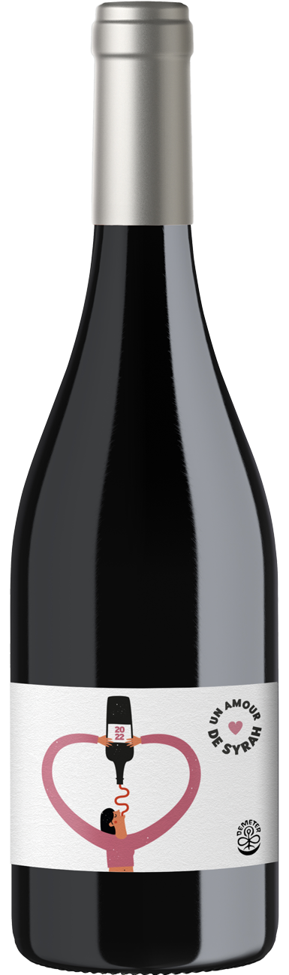
ABG PRODUCT DECK
UN AMOUR DE SYRAH
CHÂTEAU BEAUBOIS - VIN DE FRANCE
"UN AMOUR" — It encapsulates a profound emotion. It speaks to our "love" for Syrah. Chateau Beaubois is nestled just 10 kilometers away from the refreshing embrace of the sea, this vineyard enjoys a uniquely mild climate that's perfect for nurturing exceptional grapes. But the passion of these 4th generation winemakers isn't limited to just the wine itself. They're dedicated eco-romantics, obsessively committed to sustainable and biodynamic farming. Immersing in this wine, one can taste not just the grapes, but the very soil and soul the vines sprung from. Amidst a sea of wine choices, this grape, with its crunchy nuances and oceanic whispers, has stolen our hearts. Here's to a wine that loves our planet as much as we adore every sip.
Winemaking
Biodynamic, Certified Vegan, Organic
Varietal Percentage
100% Syrah
Sustainability
76% less energy for production
79% less carbon emissions
33% less water
Lightweight bottle (390 g)
Consumers in France recycle their empty bottles & receive fresh bottles of Syrah, like an old school milkman!
Food Pairings
Rosemary lamb lollipops
Ginger-lime glazed salmon
Sun-dried tomato
Tasting Notes
Blackberry
Wild herbs
Sea Stone

