Slide 1
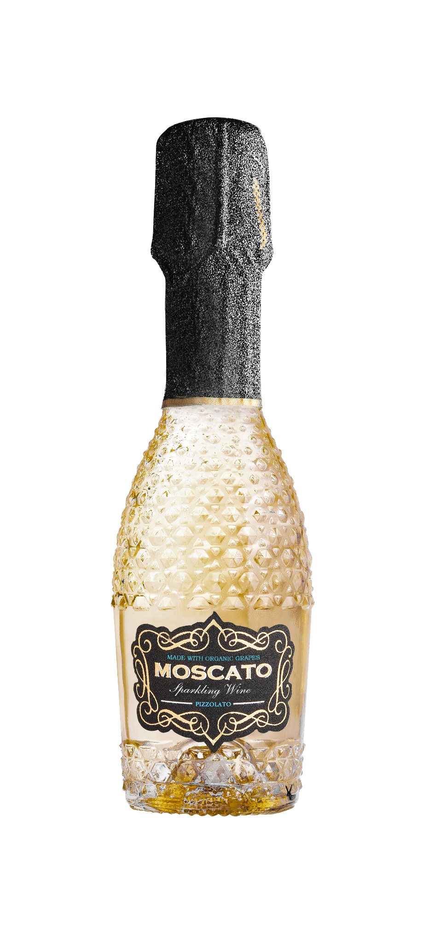


ABG PRODUCT DECK
PIZZOLATO SPARKLING MOSCATO MINIS
SPARKLING WINE
Uncork Italian sunshine! This vibrant beauty hails from the rolling hills near the Piave River, where golden organic Moscato grapes bask in the Veneto's warmth. The first whiff whispers of honeysuckle, ripe apricot, and ethereal angel food cake. Round and full-bodied, it bursts with sweet apple, peach nectar, and a touch of orange marmalade, all kissed with honeyed sweetness. The finish is smooth and refreshing, a lingering echo of pure Moscato delight. Pizzolato is sunshine in a glass, ready to ignite every celebration. Pizzolato's commitment to sustainability goes beyond the vineyard, the Pizzolato family's commitment to sustainability extends to the unique M*USE bottle, designed to be treasured, not tossed.
Winemaking
Soft pressing, then the must remains in steel pressurized tanks, with Charmat method for 2 months, reaching up to a pressure of 2.5 atm.
Tasting Notes
Honeysuckle
Ripe apricot
Angel food cake
Varietal Percentage
100% Moscato
Technical Information
6.5% Abv Alc
89g/l RS
5.4 g/l acidity
750ML/187ML

