Slide 1
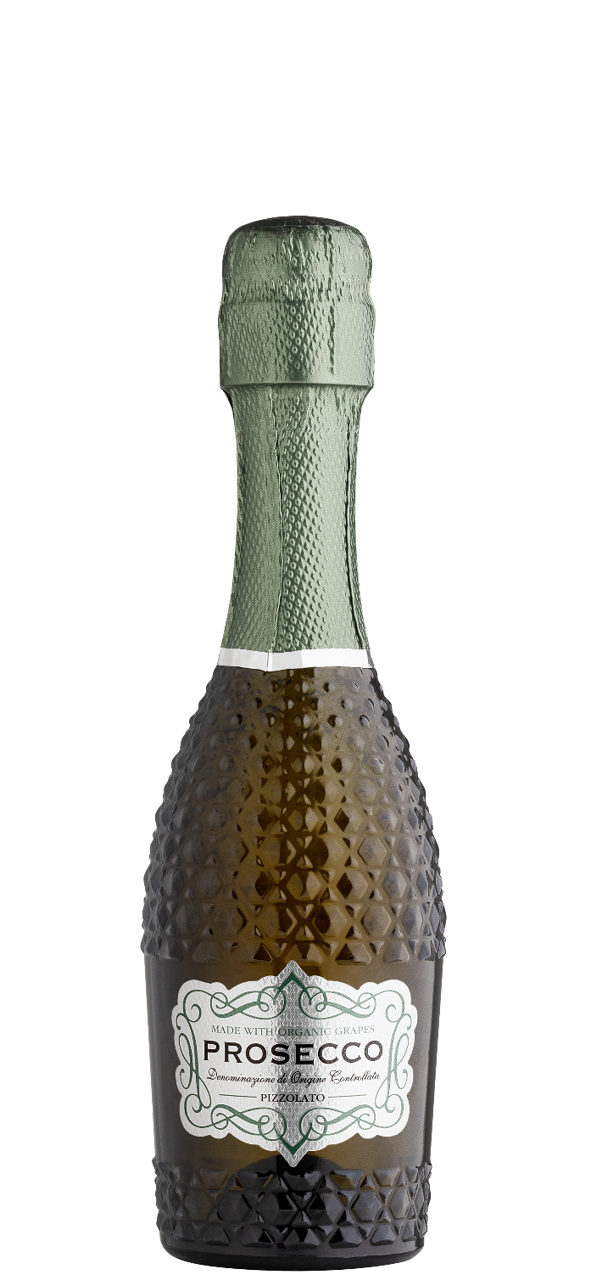

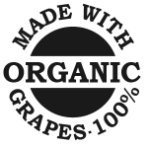
ABG PRODUCT DECK
PIZZOLATO PROSECCO
DOC PROSECCO SPUMANTE BRUT
Located in the Veneto region, La Cantina Pizzolato produces Italy’s #1 selling organic Prosecco. The organic vineyards are situated on the plains and hillsides in the rich and flourishing countryside north of Treviso. For more than five generations, the Pizzolato family has worked to live in harmony with nature and the environment.The family's desire to maintain the balance of the countryside ecosystem drove them to be among the first wine producers in Italy to produce organically starting in the 1980's. Crafted with 100% Glera grapes, the Prosecco bursts with aromas of jasmine, beeswax, and Bosc pear. On the palate, juicy elegance leads with notes of green apple, lemon zest, and hazelnut, all lifted by vibrant acidity and refined, persistent bubbles. Pizzolato's commitment to sustainability extends beyond the vineyard to the unique M*Use bottle. Inspirational muse to multi-use; it was created to be reused as a design object in your most beautiful spaces.
Winemaking
Grapes handpicked and vinified using the Italian Charmat method, with temperature-controlled fermentation in stainless steel and secondary fermentation in sealed tanks for 30 days.
Tasting Notes
Jasmine
Green Apple
Pear
Pressed flowers
Varietal Percentage
100% Glera
Technical Information
11% Abv Alc
8g/l RS
0.11 g/l acidity
750ML/187ML

