Slide 1
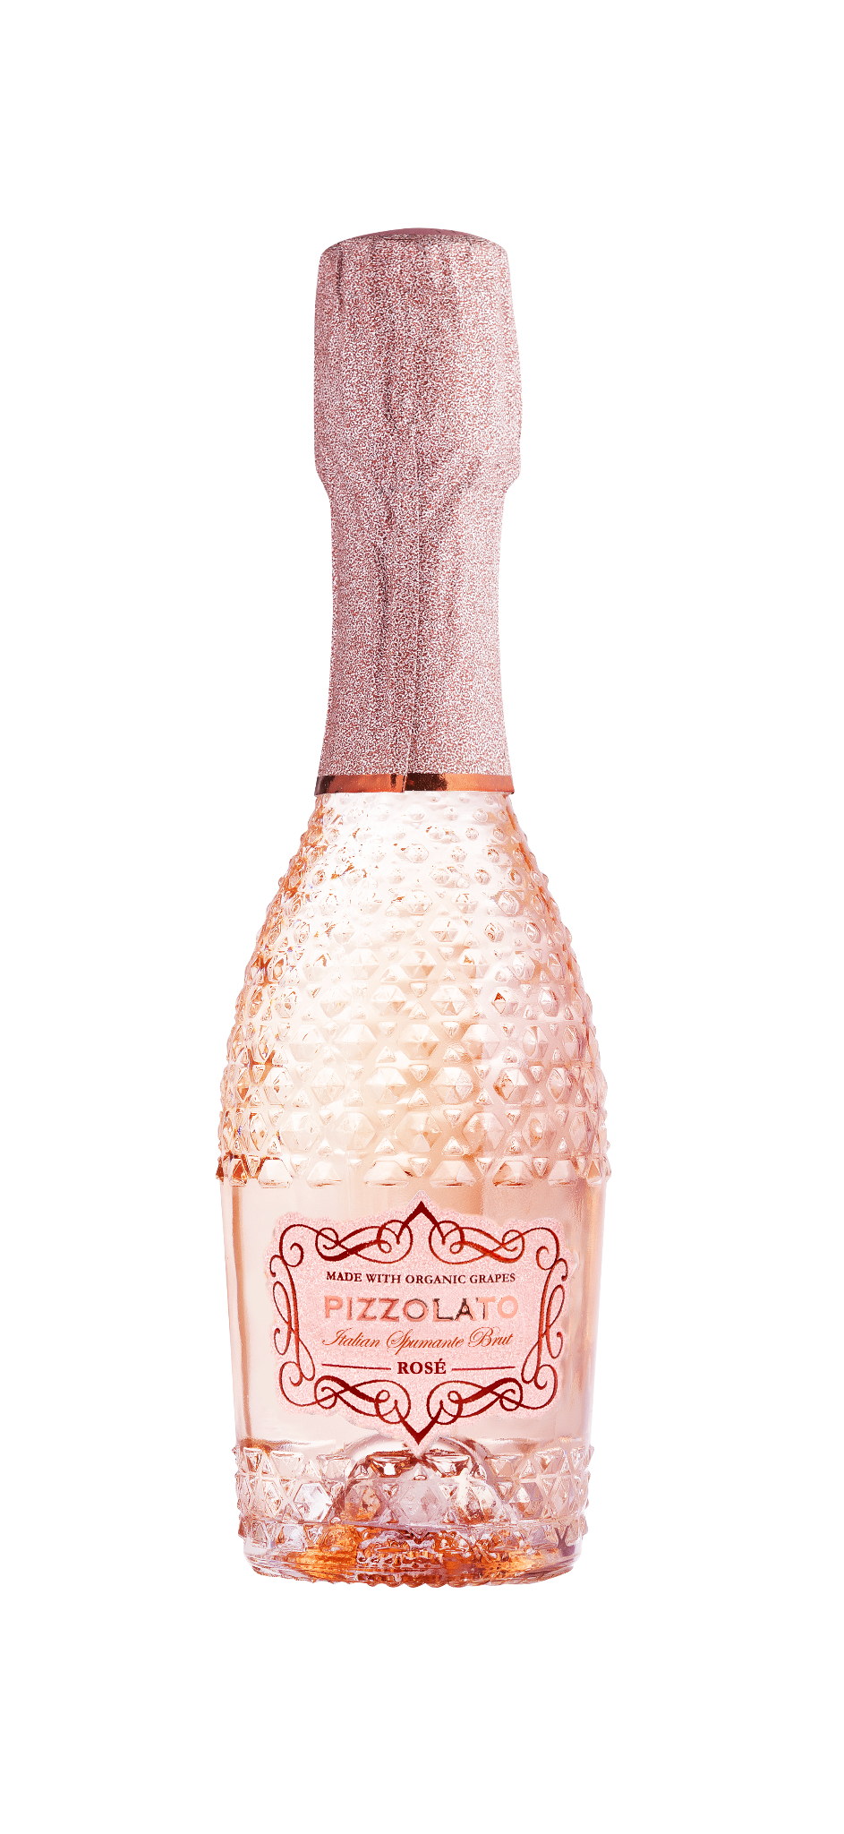


ABG PRODUCT DECK
PIZZOLATO SPARKLING ROSÉ MINIS
SECCO SPUMANTE BRUT
Pizzolato's Sparkling Rosé isn't just bubbles, it's a vibrant melody from the sun-drenched plains of Veneto, where the Piave River whispers through vine-kissed hills. 95% organic Glera grapes bring juicy apple and peach aromas, while 5% organic Raboso adds a peppery twist of wild strawberry. Delicate bubbles dance on the palate, carrying a whisper of sweetness. Pizzolato's commitment to sustainability goes beyond the vineyard, the Pizzolato family's commitment to sustainability extends to the unique M*USE bottle, designed to be treasured, not tossed.
Winemaking
The first step is a traditional white wine vinification, keeping the temperature between 15-17° C to preserve the quality of the grapes. Next, 5% Raboso is added and a natural fermentation occurs in steel tanks at controlled temperatures for at least 60 days.
Tasting Notes
Wild Strawberry
Ripe Apple
Summer Peach
Almonds
Varietal Percentage
95% Glera
5% Raboso
Technical Information
11% Abv Alc
12g/l RS
5.7 g/l acidity
750ML/187ML

