Slide 1
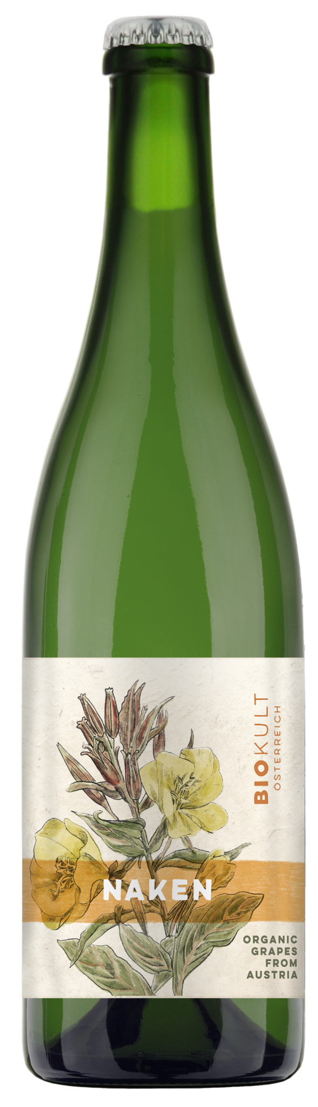

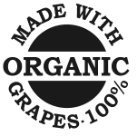
ABG PRODUCT DECK
BIOKULT NAKEN
BURGENLAND, AUSTRIA
Biokult, located in Pamhagen in the Niederösterreich region of Austria, produces fine Austrian organic wines. Biokult unites a group of organic vintners with the shared goal of producing organic wines of the highest quality – wines that embody regional identity and bring pure, natural enjoyment in the glass. Naken is a unique part of the Biokult family, this deliciously funky natural wine could be the best "beer lovers wine" in our portfolio. Reminiscent of a Belgian wheat beer with a frothy nature and immediate yeasty aromas, followed by citrus and floral notes. The palate brings orange peel, honey and honeysuckle, with notes of cardamom, cinnamon and cloves.
Winemaking
Organic Grapes, No Sugar, Pet-nat
Varietal Percentage
90 % Organic Pinot Gris
10 % Organic Muskateller
Tasting Notes
Yeasty
Orange peel
White flowers
Cloves
Food Pairings
Burgers
French Fries
BBQ
Fun Times

