Slide 1
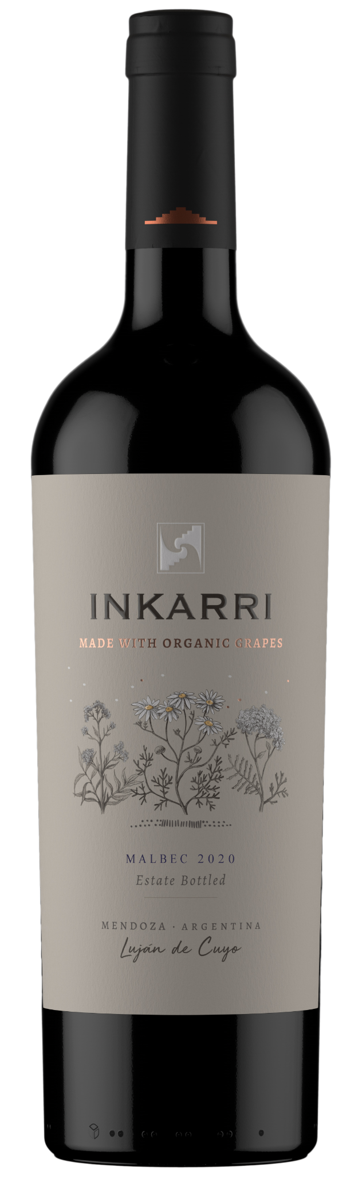
ABG PRODUCT DECK
INKARRI MALBEC
MENDOZA, ARGENTINA
Sun-kissed Mendoza magic in every sip. Inkarri Malbec bursts with juicy cherries and plums, kissed by earth and desert herbs. Oak adds velvety whispers, but concrete keeps it fresh and wild. Raise a glass to this biodynamic tango of terroir – bold, vibrant, and begging to be shared.
Winemaking
Certified Vegan, Organic Grapes, No Sugar, Demeter Certified Biodynamic
Varietal Percentage
100% Organic Malbec
Tasting Notes
Coffee
Cranberry
Dark Plum
Pepper
Food Pairings
Steak
Braised Meats
Sausages
Stuffed Mushrooms

