Slide 1
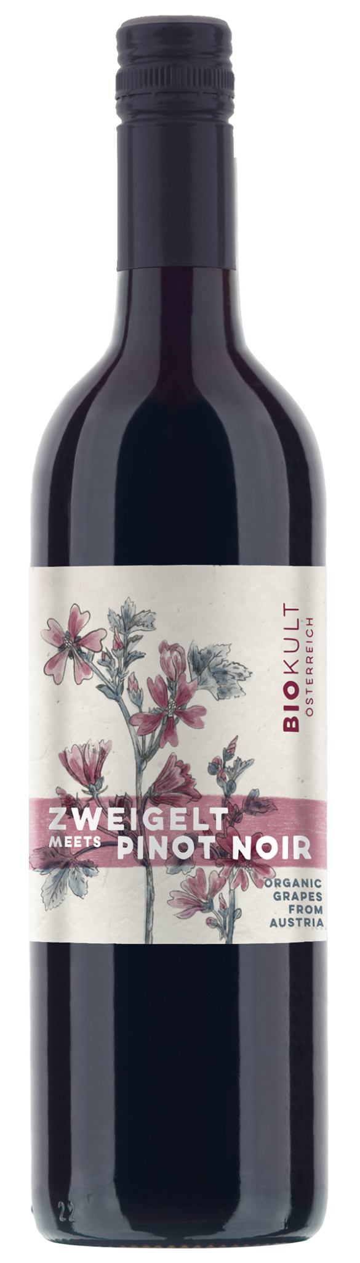

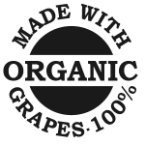
ABG PRODUCT DECK
BIOKULT ZWEIGELT + PINOT NOIR
BURGENLAND, AUSTRIA
Biokult, located in Pamhagen in the Niederösterreich region of Austria, produces fine Austrian organic wines. Biokult unites a group of organic vintners with the shared goal of producing organic wines of the highest quality – wines that embody regional identity and bring pure, natural enjoyment in the glass. This Red Blend has a juicy cherry flavor that explodes on your palate, both ripe and refreshingly tart. As you finish the sip, a hint of spice and a touch of earthiness emerge, along with subtle tannins.
Winemaking
Organic Grapes, No Sugar
Varietal Percentage
50% Organic Zweigelt
50% Organic Pinot Noir
Tasting Notes
Cherry
Spice
Cranberry
Rhubarb
Food Pairings
Charcuterie
Barbeque
Fried chicken
Picnic salads

